Slide 1
The Correlation Between
Countries’ Financial Indicators and their Happiness Level
Jiacheng Zhang, Yue Wang, Anuja Apte, Muhammad Faiq Nasir, Owakhela Kankhwende

Slide 2
Outline
Problem Statement
Data Description
Data Preprocessing
Descriptive Figures
Logistic Regression Model
Results
Conclusion

Slide 3
Problem Statement
Our business problem is to understand the relationship between the financial indications and the happiness level of a country
1
2
3
What is the relationship between happiness level and financial indicators?
Where are the happy countries to live in the world?
What things government could do to increase happiness level for public?

Slide 4
Data Description
Data Characteristics
Source: Gallup World Poll, World Bank and World Happiness Report
Countries: 145
Size: 12 variables x 1559 rows x 13 years = 180,804
Number of years: 13
Period: 2006 - 2018
Additional Information
Secondary data obtained from the Gallup World Poll and World bank, who acquired the data from surveys and statistical systems of member countries
Started with 215 countries but had to cut down to 145 due to missing values
Notes:
Data Characteristics
Source: Gallup World Poll, World Bank and World Happiness Report
Countries: 145
Size: 12 variables x 1559 rows x 13 years = 180,804
Number of years: 13
Period: 2006 - 2018
Additional Information
Secondary data obtained from the Gallup World Poll and World bank, who acquired the data from surveys and statistical systems of member countries
Started with 215 countries but had to cut down to 145 due to missing values

Slide 5
Data Preprocessing
Check the missing value
Categorical and numerical
Import the data-set
Split the data-set
Import the libraries
Feature scaling and building
Preprocessing in machine learning about happiness level ranking

Slide 6
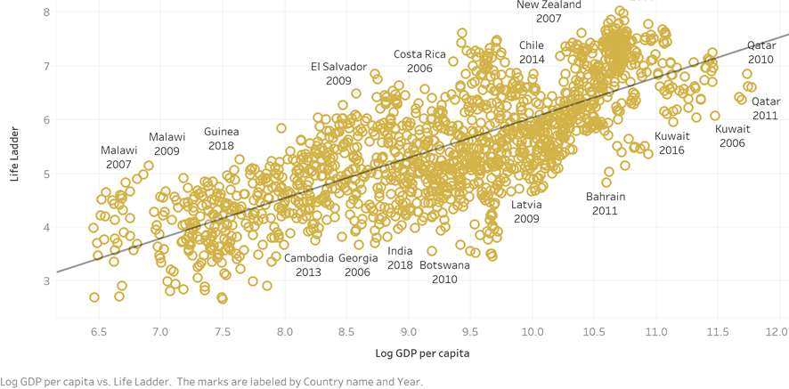
Log GDP per Capita vs Life Ladder Score
Relationship
There is a strong positive relationship defined by trendline formula of 0.748265*Log GDP per capita + -1.451
Variable
Log GDP per capita has great value as a predictor given p-value < 0.0001
Model
The regression model has good value given R-Squared measure of 0.600911

Slide 7
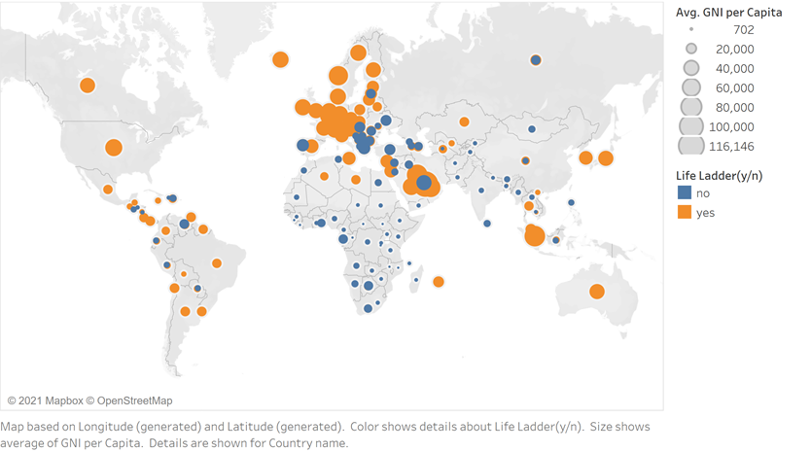
Average GNI per Capita vs Life Ladder Grouping
Relationship
The “Yes” group exhibits higher Average GNI per Capita often. There appears to be some positive correlation on large scale.
Variable
Average GNI per Capita has decent descriptive importance
Graph
There is quite a clear delineation between the two groups as well very strong Geographical trends

Slide 8
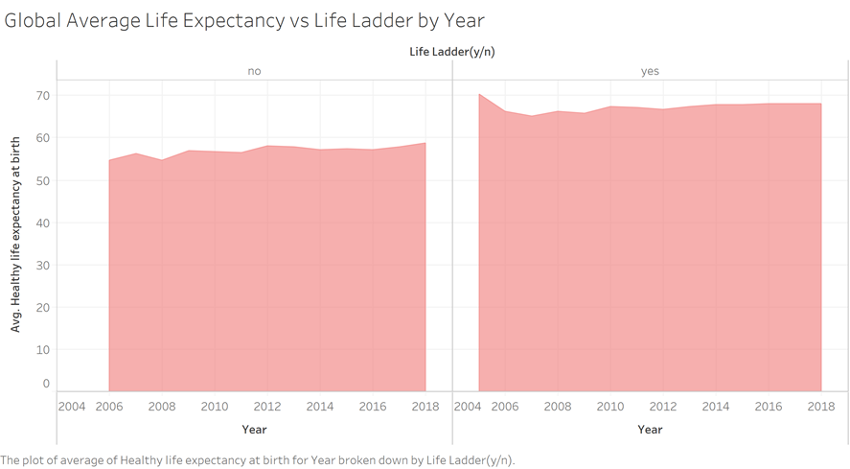
Average Healthy Life Expectancy at Birth vs Life Ladder Grouping by Year
Relationship
The “Yes” group which is Life Ladder Scores of > 0.5 has notably higher Average Healthy Life Expectancy. It appears to be a positive relationship
Variable
Average Healthy Life Expectancy has decent descriptive importance as per the graph
Graph
The graph details a steady average increase in year to year Average Healthy Life Expectancy

Slide 9
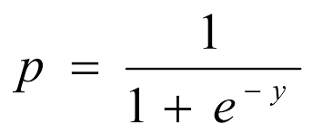
Logistic Regression
Log GDP per capita | 0.948133
Social support | 0.296414
Healthy life expectancy at birth | 0.619485
Freedom to make life choices | 0.208649
Generosity | 0.140581
Perceptions of corruption | - 0.005017
GNI | - 0.242595
Total_reserve | 0.007173
According to the finalized test result, we choose logistic regression model as our predictive approach to better predict our goal based on its high accuracy rate.
Provides a measure of a coefficient size is, as well as its direction of association
According to the feature selection, we also calculate the coefficient of each feature
In the results chart and coefficient table, log GDP per capita became the most vital factor that will affect the happiness level of citizen in the country around the world.

Slide 10
Results
There was a positive correlation between the GDP per capita and the Happiness Ladder
GNI has a negative correlation with the happiness Ladder ,however the observed correlation wasn’t significant with coefficient <0.5
Another interesting finding of the study suggests a strong positive correlation between the Healthy Life Expectancy at Birth and the Happiness Ladder

Slide 11
Conclusion & Implications
Financial freedom of a country impacts the happiness level
If a country aims at improving its happiness level, it should introduce initiatives that work towards promoting economic development as that would lead to higher GDP per capita, hence improving the happiness level
Life expectancy at birth promotes the happiness level of a country
Policy makers should invest in health programs to improve the country’s life expectancy as it would help increase the happiness level for the country

